Slide 1

NETFLIX – TV SHOWS AND MOVIES Data Cleaning & Analysis
Team Members
Apurva Padwal
Manpreet Kaur Gurtatta
Mausam Shah
Vabhavi Tickoo
Yanvi Soni

Slide 2
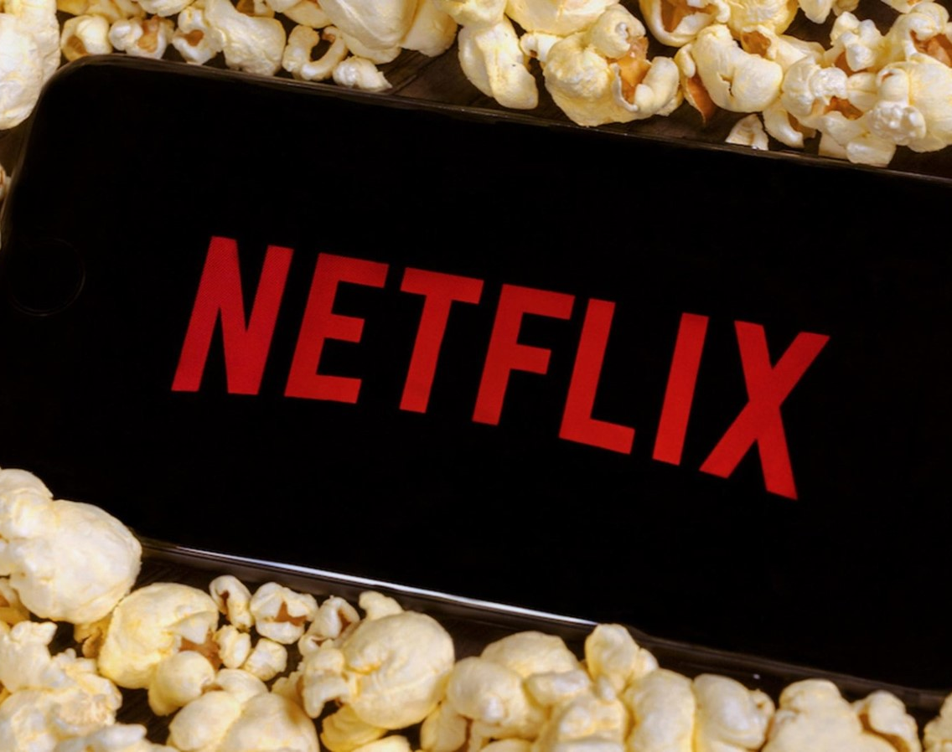

Introduction
Netflix, one of the world's largest streaming providers, has a massive collection of content spreading from classics of all time to original productions. We have selected the Netflix TV Series and Movies dataset in order to obtain an understanding of this heterogeneous collection. This dataset contains a multitude of information, such as ratings, audience compatibility, titles and their genres, and much more.
Using the extensive dataset that we found, we explore the fascinating world of films and TV series that are available on Netflix in this research. Understanding consumer preferences and content trends is essential for platforms like Netflix to improve user experience and customize their offers as the streaming market changes.

Slide 3
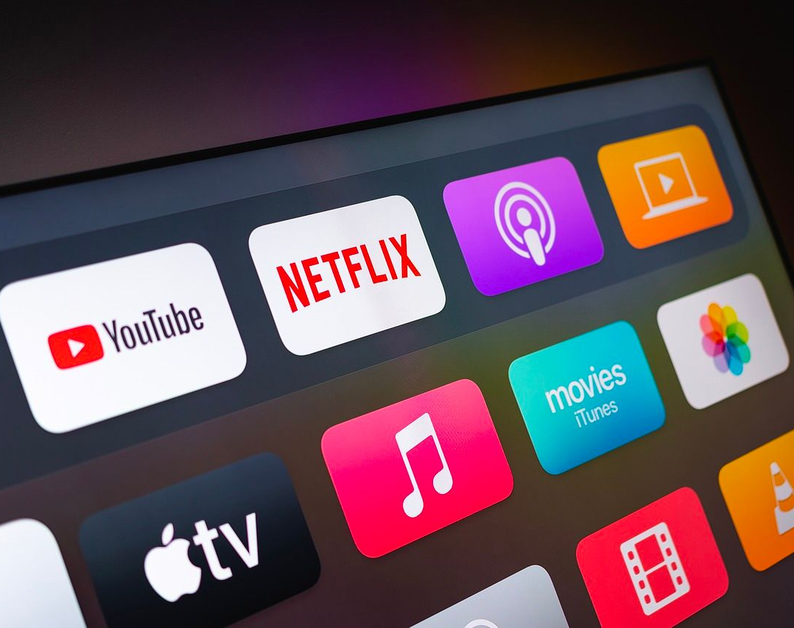
Dataset Description
Source: Kaggle
This dataset contains almost 5000+ distinct rows and 15 columns from Netflix, such as:
TMDb Score (tmdb_score)
ID (id)
Title
Runtime
Seasons
IMDb Votes (imdb_votes)
TMDb Popularity (tmdb_popularity)
Type (show_type)
Description
Release Year
Age Certification
Genres
Production Countries
IMDb ID
IMDb Score (imdb_score)

Slide 4
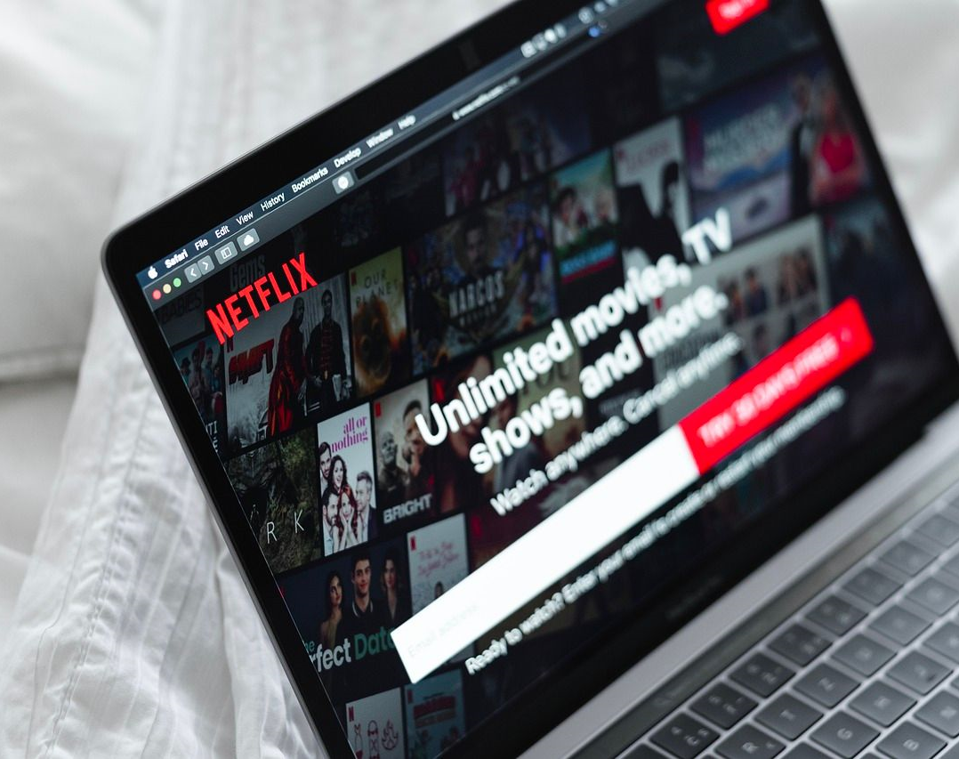
TOOLS AND TECHNOLOGIES USED
Programming Language: Python
Integrated Development Environment (IDE): Jupyter Notebook
Python Libraries:
NumPy
Pandas
Matplotlib
Altair
Seaborn
Data Cleaning and Processing: Regular Expressions (re)

Slide 5
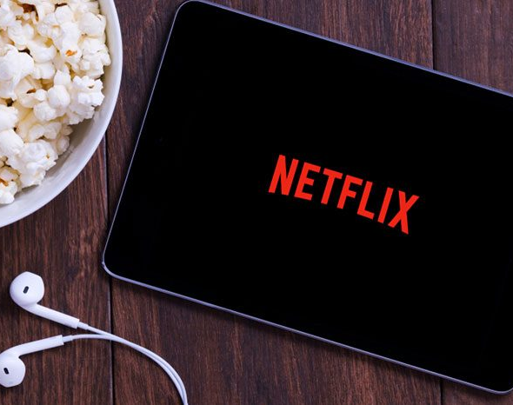
METHODOLGY
Data Collection
EDA (Exploratory Data Analysis)
Data Cleaning
Data Validation
Data Visualization

Slide 6

Data Cleaning
Basic Data Cleaning
Data cleaning is an essential step to ensure the reliability and accuracy of our analysis. In this section, we will perform basic data cleaning to make the dataset usable. More advanced data cleaning will be conducted in subsequent sections if necessary.
Handling Missing Values
Upon initial inspection, we identified that the majority of the missing values are concentrated in the "age_certification" and "seasons" columns.
Notably, the "title" column contains a non-recognizable NaN value, and only one item is missing a title. To maintain data integrity, we have decided to directly remove this entry.
Age Certification (age_certification)
To address missing values in the "age_certification" column, we cross-referenced the available categories with Netflix's age rating list.
Remarkably, the dataset encompasses all age ratings recognized by Netflix. The missing values are attributed to movies or shows that haven't been rated on the website from which the data was sourced.
Seasons (seasons)
It was observed that all the missing values in the "seasons" column are associated with movies. Given that movies don't have seasons, we decided to fill these entries with 0 to represent the absence of seasons.
Filling NaN Values
We applied the approach of filling NaN values in "age_certification" and "seasons" columns using their own average values. This maintains the integrity of the data while addressing missing information.

Slide 7
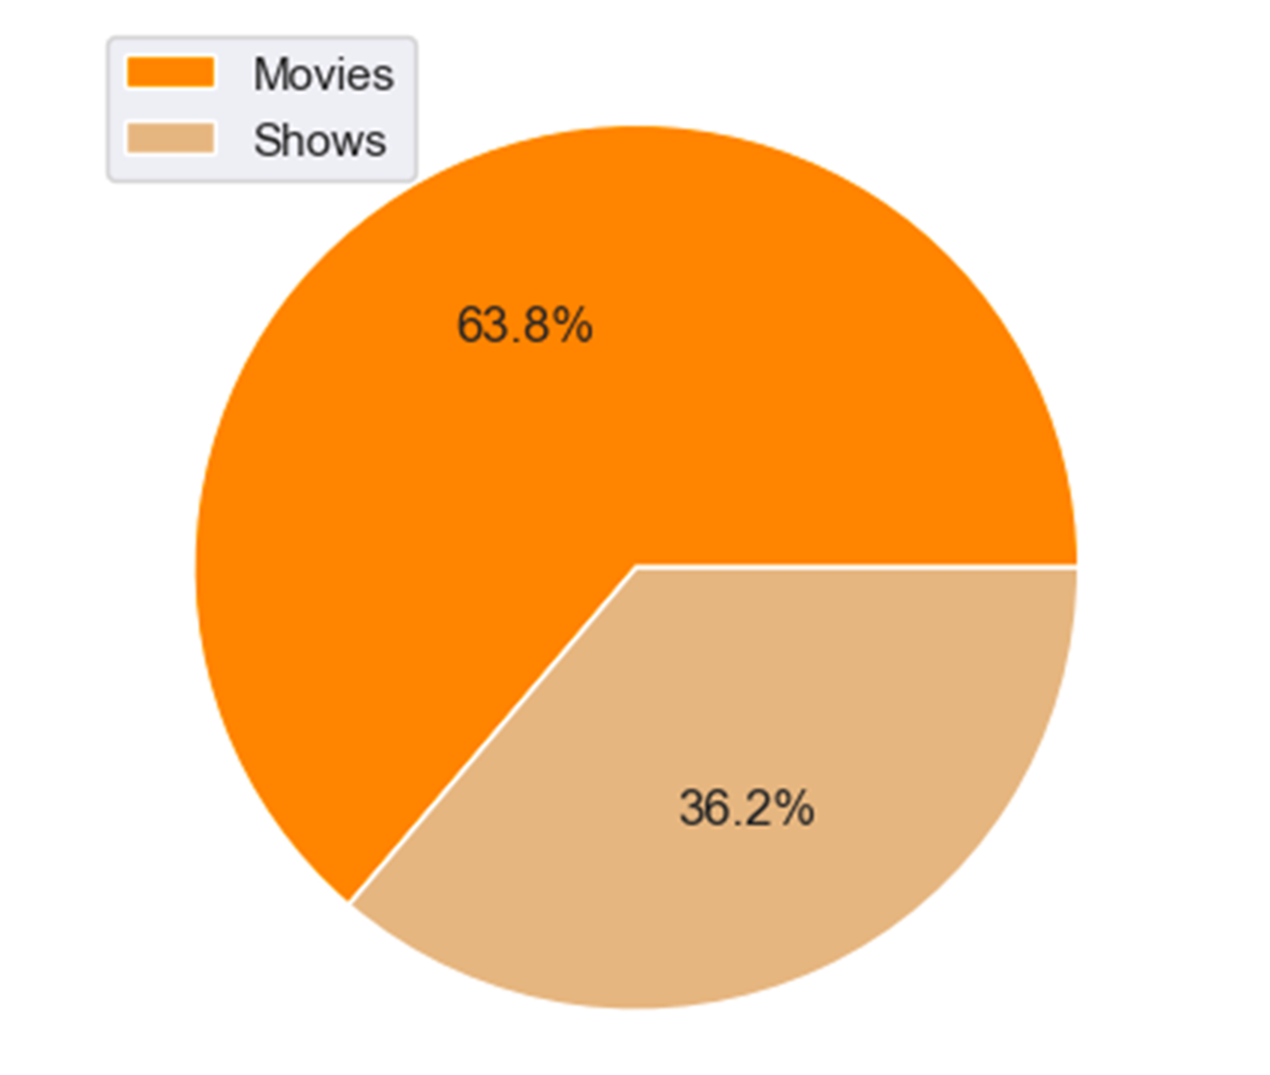
DISTRIBUTION OF SHOWS AND MOVIES IN NETFLIX
Notes:
Hello everyone. I'm Vabhavi. The topic for my presentation is “Battle against the Spread of Misinformation on Instagram!”
Instagram continues to be one of the fastest growing social networks and currently has more than one billion users. While Instagram has not been a focus of investigations into misinformation, it has not been immune to bad actors & fake news.

Slide 9
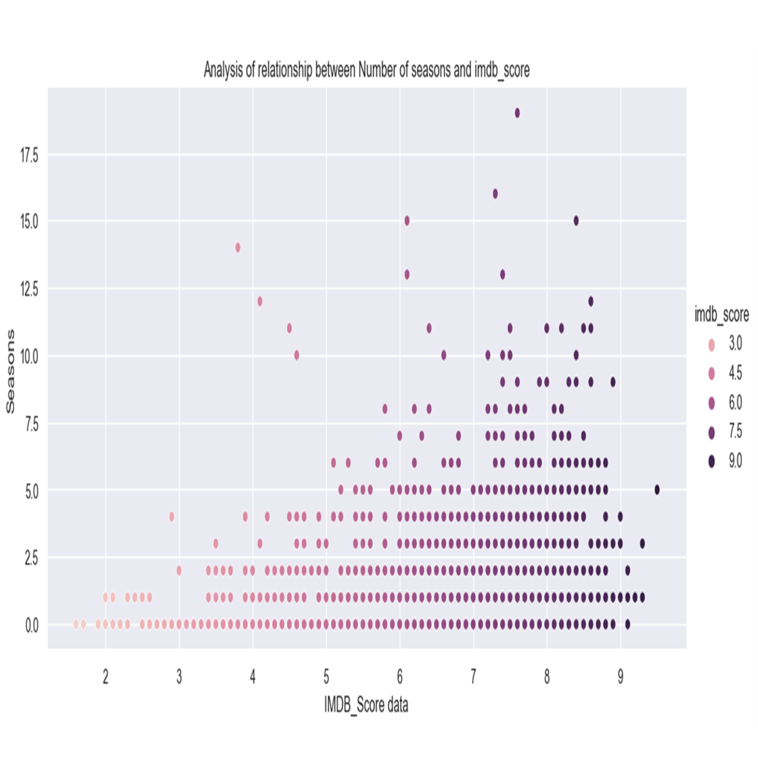
RELATIONSHIP BETWEEN NUMBER OF SEASONS AND IMDB SCORE
Notes:
Hello everyone. I'm Vabhavi. The topic for my presentation is “Battle against the Spread of Misinformation on Instagram!”
Instagram continues to be one of the fastest growing social networks and currently has more than one billion users. While Instagram has not been a focus of investigations into misinformation, it has not been immune to bad actors & fake news.

Slide 11
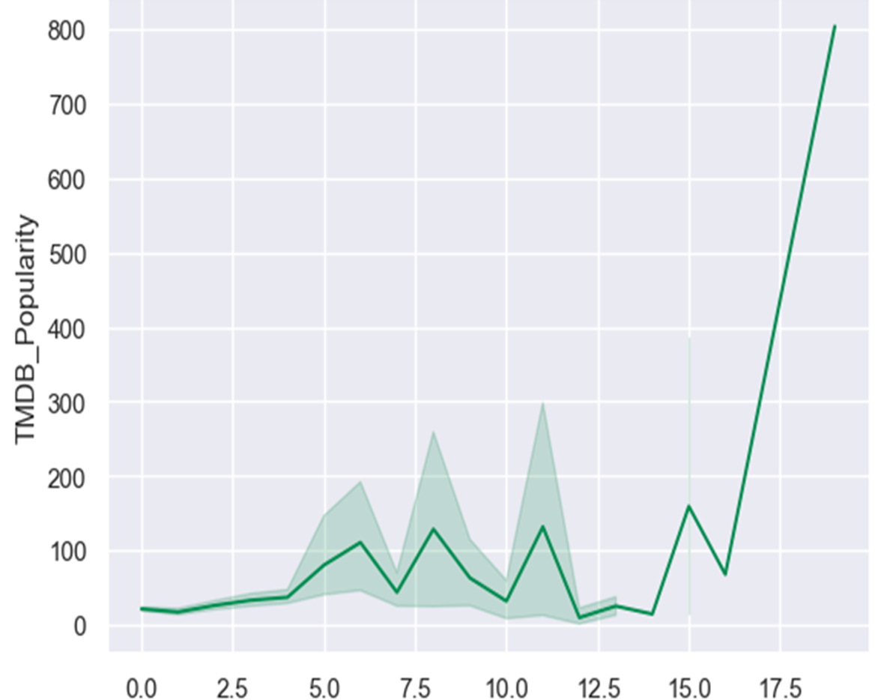
DISTRIBUTION OF TMBD POPULARITY FOR EACH SEASON
Notes:
Hello everyone. I'm Vabhavi. The topic for my presentation is “Battle against the Spread of Misinformation on Instagram!”
Instagram continues to be one of the fastest growing social networks and currently has more than one billion users. While Instagram has not been a focus of investigations into misinformation, it has not been immune to bad actors & fake news.

Slide 12
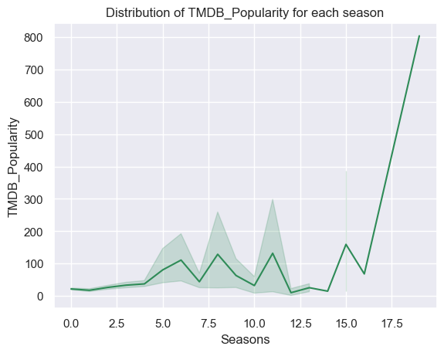

Slide 13
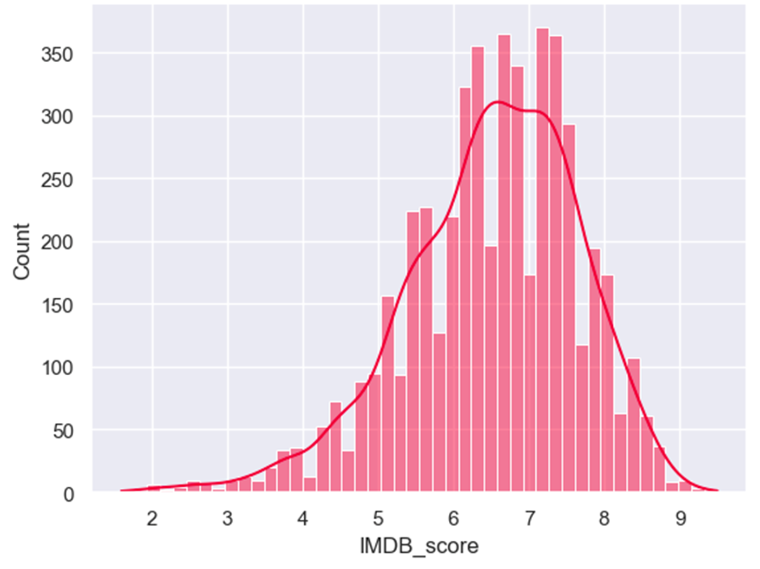
DISTRIBUTION OF IMDB SCORE
Notes:
Hello everyone. I'm Vabhavi. The topic for my presentation is “Battle against the Spread of Misinformation on Instagram!”
Instagram continues to be one of the fastest growing social networks and currently has more than one billion users. While Instagram has not been a focus of investigations into misinformation, it has not been immune to bad actors & fake news.

Slide 15

Thank You!

